Slide 1
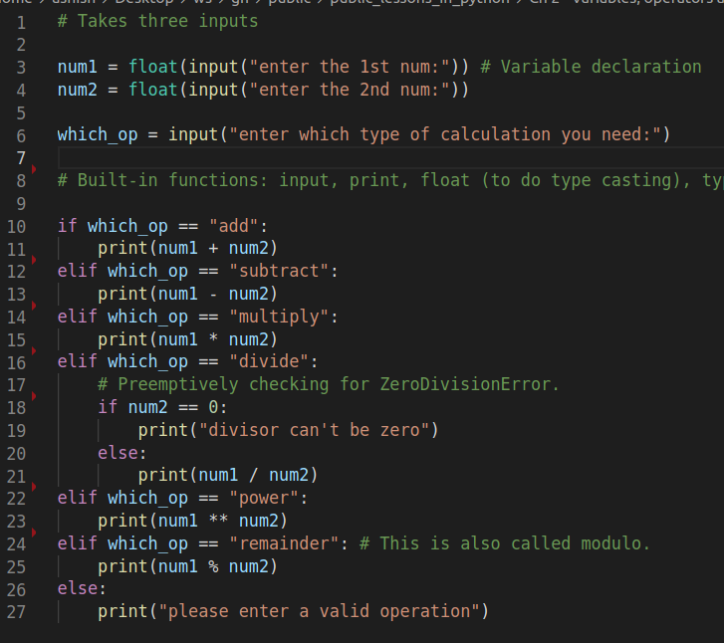
Calculator: We intend to demonstrate simple arithematic operations on numbers
1. How to take to input?
2. Arithematic Operators:
Assignment operator: Line 1
Equality operator: Line 4
Addition operator: Line 5
Modulo operator: Line 19
3. String comparison:
In line 10, 12, 14...: we are comparing value of string type variable with string literal.

Slide 2
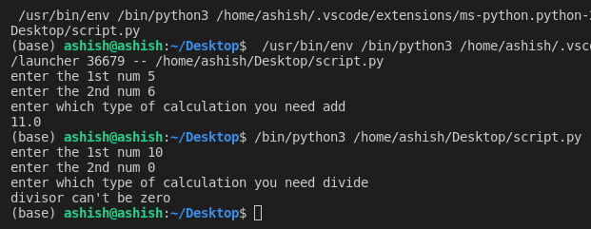
Calculator: Output

